Slide 1

Lesson 11
Substance use and addiction
Ages 12–15

Slide 2
Types of substances:
Alcohol
Marijuana
Tobacco or nicotine
Hallucinogens
Stimulants
Opioids
Sedatives
Inhalants
2 / 11

Slide 3
Substance Use and
Addiction Quiz
TRUE OR FALSE?
When youth use substances, they use illegal drugs more than alcohol or marijuana.
Intoxication from alcohol affects your judgment and your behaviour.
Driving a motor vehicle after smoking marijuana is not as dangerous as driving after drinking alcohol.
3 / 11

Slide 4
Substance Use and
Addiction Quiz
TRUE OR FALSE?
Vaping is harmful to your health.
Binge drinking is harmless fun.
Mixing alcohol and drugs is not more dangerous than using them separately.
A young brain is more susceptible to the effects of alcohol and drugs than an adult brain.
4 / 11

Slide 5
Substance Use and
Addiction Quiz
TRUE OR FALSE?
Substance use becomes “abuse” when drugs or alcohol start to have a negative effect on a person’s life and interfere with their mental and physical well-being.
Inhalants give you a short-term high, so they are less dangerous than other drugs.
Substance use is a good way to let go and cope with stress when things get too big to handle.
5 / 11

Slide 6
Risk factors:
Experimenting with alcohol and drugs at a young age
Family members that regularly drink and use drugs around the house
Being abused, bullied, or harassed
Having friends who experiment with drugs and alcohol
6 / 11

Slide 7
RESILIENCY
“Resiliency” is the ability to move forward and to cope with obstacles and negative events that can happen in life.
7 / 11

Slide 8
Protective factors:
Ability to deal with stress and to problem solve
Ability to connect with others
Having a safe and trustworthy person to whom you can reach out for help
Ability to express, and deal with, emotions
Being optimistic and excited about the future
Being part of a school club, a sports team, a community program, or volunteering for a cause
School / organizational / program / community policies to reduce abuse, bullying, and harassment
Culture
8 / 11

Slide 9
Impacts
Physical:
Harm to the brain
Liver damage
Blackouts, seizures, and vomiting
Alcohol poisoning
Injury or death from drinking and driving
Injury or death from a drug overdose
Infections from used needles such as HIV / AIDS and hepatitis
9 / 11

Slide 10
Impacts
Emotional:
Mental health disorders such as anxiety or depression
Psychotic episodes that can include hallucinations, hearing voices, and violent and dangerous behaviours
Unable to use healthy coping strategies to deal with stress and feelings of sadness and anxiety
Unable to focus on school work or a job due to memory loss, anxiety, and confusion
10 / 11

Slide 11
Impacts
Social / Relational:
Lying and hiding substance use from family and friends
Conflicts and fights with family and friends
Loss of trust with family and friends
Breakup of dating relationships due to substance use
Quitting or being expelled from extracurricular activities, sports, or the cadet / JCR program
Unable to have fun without using substances
11 / 11

Slide 12




LINK
LOOK
LISTEN
LIVE
1 / 5
Notes:
Copyright © 2020 The Canadian Red Cross Society
LOOK: Are they acting different than before? Are they: sad, anxious, angry, and alone all the time, drinking and using drugs, taking big risks, hurting themselves or others.
We need to be looking out for each other and checking in with teammates and friends.

Slide 13
STEP 1: LOOK
Sad
Angry
Taking big risks
Hurting themselves or others
Using drugs and alcohol
Anxious
Alone
2 / 5
Notes:
Copyright © 2020 The Canadian Red Cross Society
LOOK: Are they acting different than before? Are they: sad, anxious, angry, and alone all the time, drinking and using drugs, taking big risks, hurting themselves or others.
We need to be looking out for each other and checking in with teammates and friends.

Slide 14
STEP 2: LISTEN
Are you okay?
Can I help?
Be calm
Be open
Listen without judgment
3 / 5
Notes:
Copyright © 2020 The Canadian Red Cross Society
LOOK: Are they acting different than before? Are they: sad, anxious, angry, and alone all the time, drinking and using drugs, taking big risks, hurting themselves or others.
We need to be looking out for each other and checking in with teammates and friends.

Slide 15
STEP 3: LINK
Cadet / JCR Leaders
Parents / Caregivers
Counsellors /
Teachers
Friends
Kids Help Phone
4 / 5
Notes:
Then we need to link them to people and/or resources.
LINK: Let them know there are people who can help. Encourage them to talk to a trusted adult or offer to go with them to talk to someone who can help. Let them know, “I want you to be safe; we need to get help.”
Copyright © 2020 The Canadian Red Cross Society
LOOK: Are they acting different than before? Are they: sad, anxious, angry, and alone all the time, drinking and using drugs, taking big risks, hurting themselves or others.
We need to be looking out for each other and checking in with teammates and friends.

Slide 16
STEP 4: LIVE
Journal
Sports / Exercise
Eat healthy
Music
Bead /
Sew /
Draw / Poetry
Time with animals
Hunt / Hike / Nature
Video / Movie theatre
Socialize
Talk to family and friends
5 / 5
Notes:
We want to ensure you are using healthy coping mechanism to deal with your stress.
What are some healthy ways to deal with stress? Have the players brainstorm a list then read out the ones on the PP.
Copyright © 2020 The Canadian Red Cross Society
LOOK: Are they acting different than before? Are they: sad, anxious, angry, and alone all the time, drinking and using drugs, taking big risks, hurting themselves or others.
We need to be looking out for each other and checking in with teammates and friends.

Slide 17





KIDS HELP PHONE
If you need one-on-one time with someone who gets what is going on in your life, you can connect anonymously with Kids Help Phone. Our counsellors are available 24 hours a day, seven days a week to support you with whatever you are going through.
CALL 1-800-668-6868 to talk with a counsellor
CHAT with a counsellor at KidsHelpPhone.ca or through the Always There App
TEXT 686868 to connect with a trained volunteer Crisis Responder
1 / 2

Slide 18
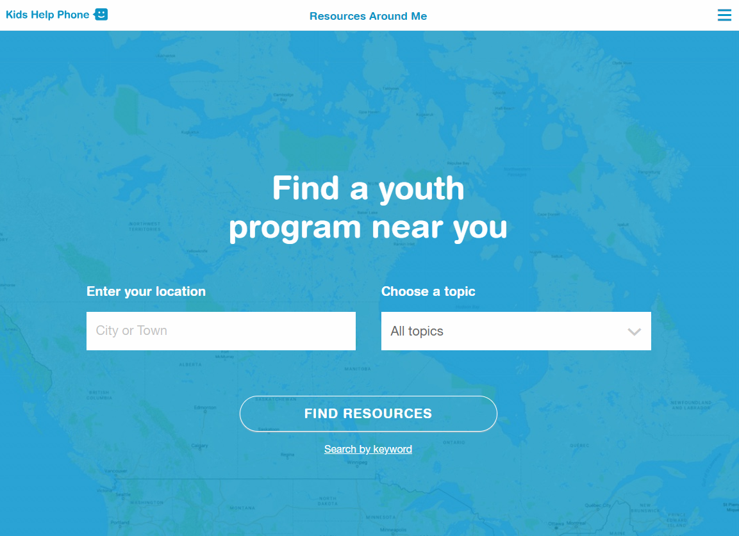
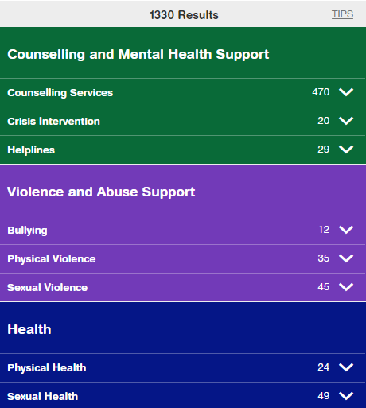
RESOURCES AROUND ME
Resources Around Me is a free, interactive tool, available in English and French, through Kids Help Phone’s website.
The tool helps young people to independently connect to local programs and services in their communities.
These services include:
  Counseling and mental health
  Sexual health
  Housing help
  Legal help
  LGBTQ2S services
  Youth shelters
kidshelpphone.ca/resourcesaroundme
2 / 2

Slide 19
Community Resources
Add local resources to this slide
1 / 1

