Slide 1
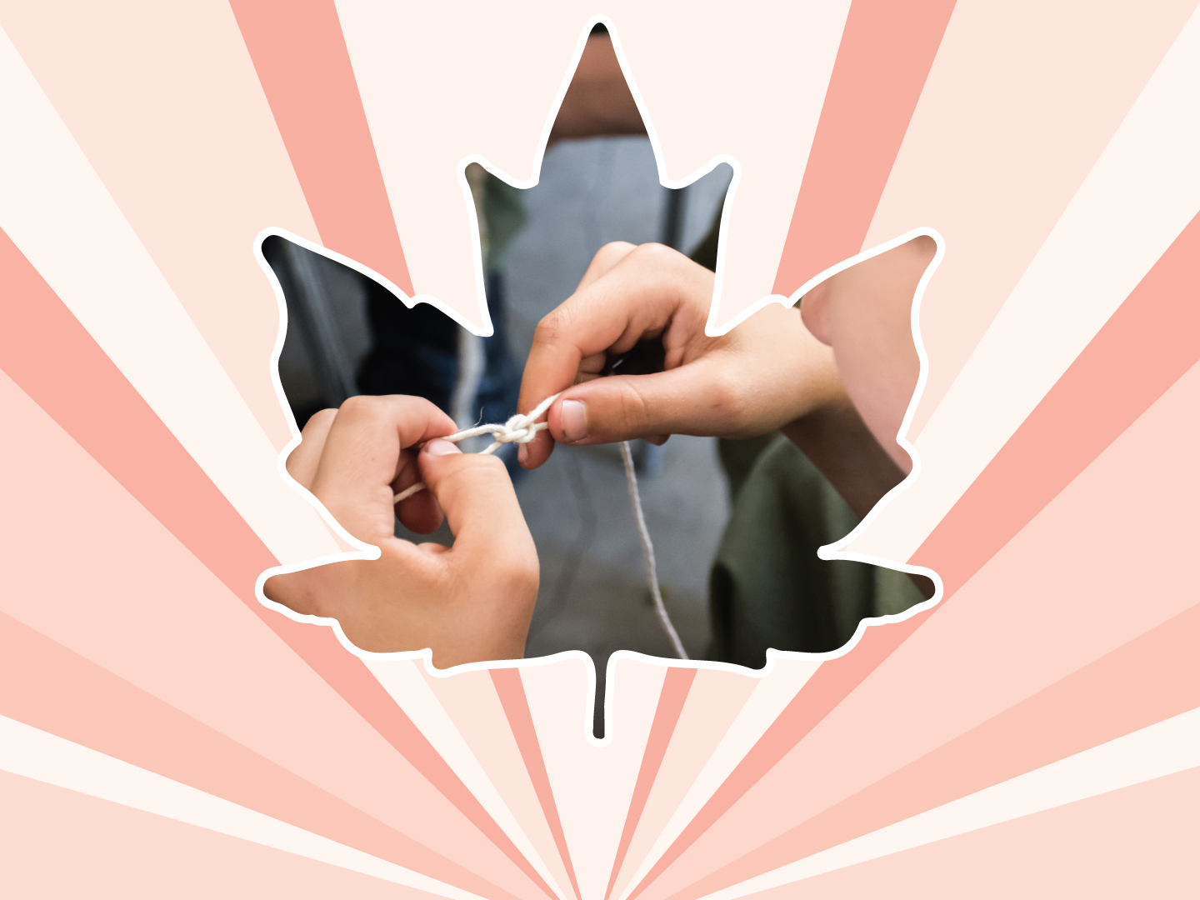
Lesson 10
Sexual Exploitation
Ages 15–18

Slide 2
Sexual exploitation
“Sexual exploitation” is the sexual abuse of children and youth through the exchange of sex or sexual acts for drugs, food, shelter, protection, other basics in life,
and / or money.
2 / 8
Notes:
Canadian Red Cross. (1997). Hearing the hurt, changing the future: Abuse prevention services for youth.

Slide 3
TYPES OF sexual exploitation:
children who are forced into
selling sex; or
children who are forced to take sexual pictures / videos of themselves that can be sent electronically (known as “child sexual abuse images”, formerly called “child pornography”).
3 / 8

Slide 4
Grooming:
STEP 1: TARGETING
STEP 2: FRIENDSHIP FORMING
STEP 3: LOVING RELATIONSHIP
STEP 4: ABUSIVE RELATIONSHIP
4 / 8

Slide 5
STEP 1: TARGETING:
Observing the child or youth and gathering information
Compliments: “I have never met anyone like you”
Being nice and making the child or youth feel valued
Giving gifts that the child or youth could not afford
Gaining trust
5 / 8

Slide 6
STEP 2: FRIENDSHIP FORMING:
Making the child or youth feel special
Intently listening to what the child or youth has to say
Being there for the child or youth when they need to talk
Offering to help and protect the child or youth
Testing out physical contact, e.g., ‘accidentally’
touching them
6 / 8

Slide 7
STEP 3: LOVING RELATIONSHIP:
Referring to the child or youth as a girlfriend /
boyfriend / partner
Establishing a sexual relationship
Lowering inhibitions, e.g., watching porn
Involving the child or youth in forbidden activities,
e.g., drinking and drugs
7 / 8

Slide 8
STEP 4: ABUSIVE RELATIONSHIP:
Isolation from family and friends
Threatening to harm the child or youth or their family members
Withholding love and affection
Emotional abuse: making the child or youth feel worthless
Physical and sexual abuse
Making the child or youth have sex with other people
Making the child or youth pose for sexual pictures or videos and posting them
Making the child or youth dependent on alcohol and drugs
8 / 8

Slide 9




LINK
LOOK
LISTEN
LIVE
1 / 5
Notes:
Copyright © 2020 The Canadian Red Cross Society
LOOK: Are they acting different than before? Are they: sad, anxious, angry, and alone all the time, drinking and using drugs, taking big risks, hurting themselves or others.
We need to be looking out for each other and checking in with teammates and friends.

Slide 10
STEP 1: LOOK
Sad
Angry
Taking big risks
Hurting themselves or others
Using drugs and alcohol
Anxious
Alone
2 / 5
Notes:
Copyright © 2020 The Canadian Red Cross Society
LOOK: Are they acting different than before? Are they: sad, anxious, angry, and alone all the time, drinking and using drugs, taking big risks, hurting themselves or others.
We need to be looking out for each other and checking in with teammates and friends.

Slide 11
STEP 2: LISTEN
Are you okay?
Can I help?
Be calm
Be open
Listen without judgment
3 / 5
Notes:
Copyright © 2020 The Canadian Red Cross Society
LOOK: Are they acting different than before? Are they: sad, anxious, angry, and alone all the time, drinking and using drugs, taking big risks, hurting themselves or others.
We need to be looking out for each other and checking in with teammates and friends.

Slide 12
STEP 3: LINK
Cadet / JCR Leaders
Parents / Caregivers
Counsellors /
Teachers
Friends
Kids Help Phone
4 / 5
Notes:
Then we need to link them to people and/or resources.
LINK: Let them know there are people who can help. Encourage them to talk to a trusted adult or offer to go with them to talk to someone who can help. Let them know, “I want you to be safe; we need to get help.”
Copyright © 2020 The Canadian Red Cross Society
LOOK: Are they acting different than before? Are they: sad, anxious, angry, and alone all the time, drinking and using drugs, taking big risks, hurting themselves or others.
We need to be looking out for each other and checking in with teammates and friends.

Slide 13
STEP 4: LIVE
Journal
Sports / Exercise
Eat healthy
Music
Bead /
Sew /
Draw / Poetry
Time with animals
Hunt / Hike / Nature
Video / Movie theatre
Socialize
Talk to family and friends
5 / 5
Notes:
We want to ensure you are using healthy coping mechanism to deal with your stress.
What are some healthy ways to deal with stress? Have the players brainstorm a list then read out the ones on the PP.
Copyright © 2020 The Canadian Red Cross Society
LOOK: Are they acting different than before? Are they: sad, anxious, angry, and alone all the time, drinking and using drugs, taking big risks, hurting themselves or others.
We need to be looking out for each other and checking in with teammates and friends.

Slide 14





KIDS HELP PHONE
If you need one-on-one time with someone who gets what is going on in your life, you can connect anonymously with Kids Help Phone. Our counsellors are available 24 hours a day, seven days a week to support you with whatever you are going through.
CALL 1-800-668-6868 to talk with a counsellor
CHAT with a counsellor at KidsHelpPhone.ca or through the Always There App
TEXT 686868 to connect with a trained volunteer Crisis Responder
1 / 2

Slide 15
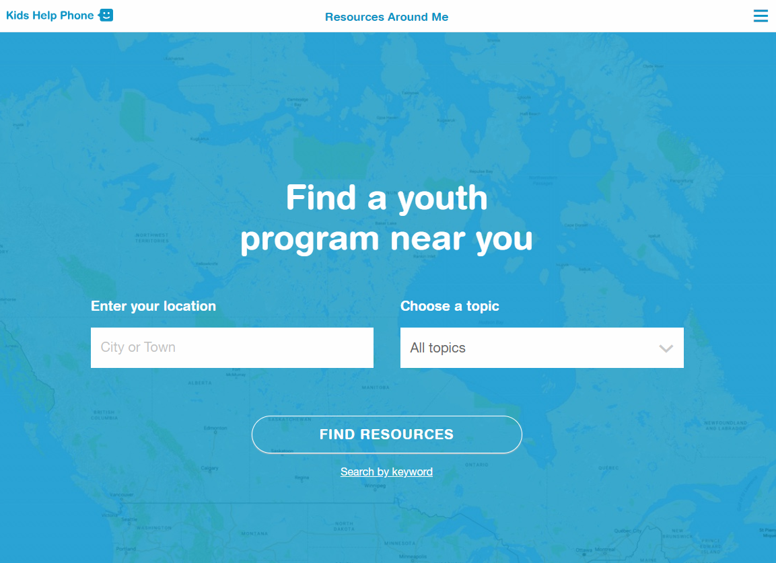
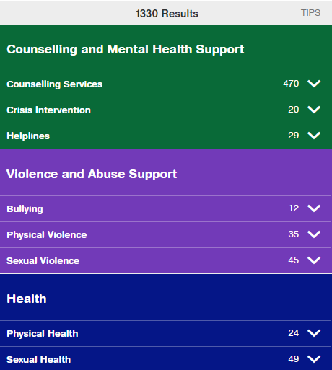
RESOURCES AROUND ME
Resources Around Me is a free, interactive tool, available in English and French, through Kids Help Phone’s website.
The tool helps young people to independently connect to local programs and services in their communities.
These services include:
  Counseling and mental health
  Sexual health
  Housing help
  Legal help
  LGBTQ2S services
  Youth shelters
kidshelpphone.ca/resourcesaroundme
2 / 2

Slide 16
Community Resources
Add local resources to this slide
1 / 1

