Slide 1
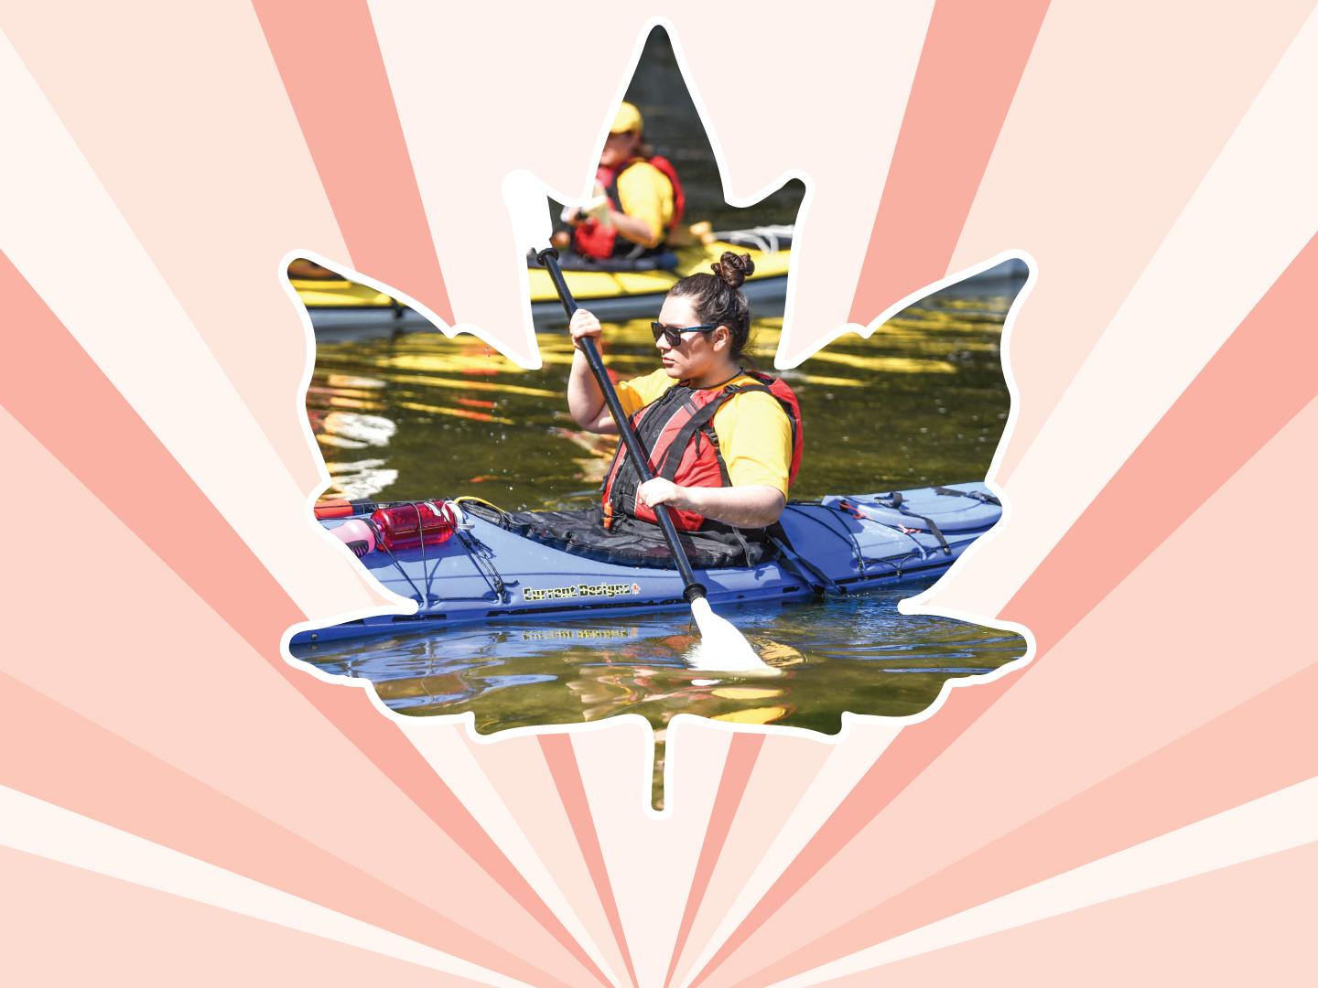
Lesson 11
Substance use and addiction
Ages 15–18

Slide 2
Impacts
Emotional:
Feel anxious
Feel depressed
Have trouble focusing on school / work
2 / 7

Slide 3
Impacts
Physical:
Harm to the brain
Injuries from fights and violence
Blackouts, hallucinations, seizures, and vomiting
Alcohol poisoning
Death from drug overdose
Death from drinking and driving
3 / 7

Slide 4
Impacts
Relational:
Hurt relationships or loss of relationships with family and friends
Loss of trust
Violence in relationships
Withdrawal from activities
Quitting school, sport, or recreational programs
4 / 7

Slide 5
Impacts
Legal:
Jail time
Fines
Criminal record
5 / 7

Slide 6
SIGNS OF SUBSTANCE ABUSE
Does the person want to cut down or stop using the substance, but cannot?
Do they spend a lot of time getting, using, or recovering from the substance?
Do they have cravings and urges to use the substance?
Do they continue the substance use even though it is causing problems in their relationships?
Is the substance use stopping them from managing school or work?
6 / 7

Slide 7
SIGNS OF SUBSTANCE ABUSE
Do they miss sports or cadet / JCR training or other social activities that are important to them due to substance use?
Do they keep using substances even though it puts them in danger?
Do they have to keep using more and more of the substance to feel the effects?
Have they developed withdrawal symptoms such as anxiety, confusion, irritability, or rapid heartbeat?
7 / 7

Slide 8




LINK
LOOK
LISTEN
LIVE
1 / 5
Notes:
Copyright © 2020 The Canadian Red Cross Society
LOOK: Are they acting different than before? Are they: sad, anxious, angry, and alone all the time, drinking and using drugs, taking big risks, hurting themselves or others.
We need to be looking out for each other and checking in with teammates and friends.

Slide 9
STEP 1: LOOK
Sad
Angry
Taking big risks
Hurting themselves or others
Using drugs and alcohol
Anxious
Alone
2 / 5
Notes:
Copyright © 2020 The Canadian Red Cross Society
LOOK: Are they acting different than before? Are they: sad, anxious, angry, and alone all the time, drinking and using drugs, taking big risks, hurting themselves or others.
We need to be looking out for each other and checking in with teammates and friends.

Slide 10
STEP 2: LISTEN
Are you okay?
Can I help?
Be calm
Be open
Listen without judgment
3 / 5
Notes:
Copyright © 2020 The Canadian Red Cross Society
LOOK: Are they acting different than before? Are they: sad, anxious, angry, and alone all the time, drinking and using drugs, taking big risks, hurting themselves or others.
We need to be looking out for each other and checking in with teammates and friends.

Slide 11
STEP 3: LINK
Cadet / JCR Leaders
Parents / Caregivers
Counsellors / Teachers
Friends
Kids Help Phone
4 / 5
Notes:
Then we need to link them to people and/or resources.
LINK: Let them know there are people who can help. Encourage them to talk to a trusted adult or offer to go with them to talk to someone who can help. Let them know, “I want you to be safe; we need to get help.”
Copyright © 2020 The Canadian Red Cross Society
LOOK: Are they acting different than before? Are they: sad, anxious, angry, and alone all the time, drinking and using drugs, taking big risks, hurting themselves or others.
We need to be looking out for each other and checking in with teammates and friends.

Slide 12
STEP 4: LIVE
Journal
Sports / Exercise
Eat healthy
Music
Bead /
Sew /
Draw / Poetry
Time with animals
Hunt / Hike / Nature
Video / Movie theatre
Socialize
Talk to family and friends
5 / 5
Notes:
We want to ensure you are using healthy coping mechanism to deal with your stress.
What are some healthy ways to deal with stress? Have the players brainstorm a list then read out the ones on the PP.
Copyright © 2020 The Canadian Red Cross Society
LOOK: Are they acting different than before? Are they: sad, anxious, angry, and alone all the time, drinking and using drugs, taking big risks, hurting themselves or others.
We need to be looking out for each other and checking in with teammates and friends.

Slide 13





KIDS HELP PHONE
If you need one-on-one time with someone who gets what is going on in your life, you can connect anonymously with Kids Help Phone. Our counsellors are available 24 hours a day, seven days a week to support you with whatever you are going through.
CALL 1-800-668-6868 to talk with a counsellor
CHAT with a counsellor at KidsHelpPhone.ca or through the Always There App
TEXT 686868 to connect with a trained volunteer Crisis Responder
1 / 2

Slide 14
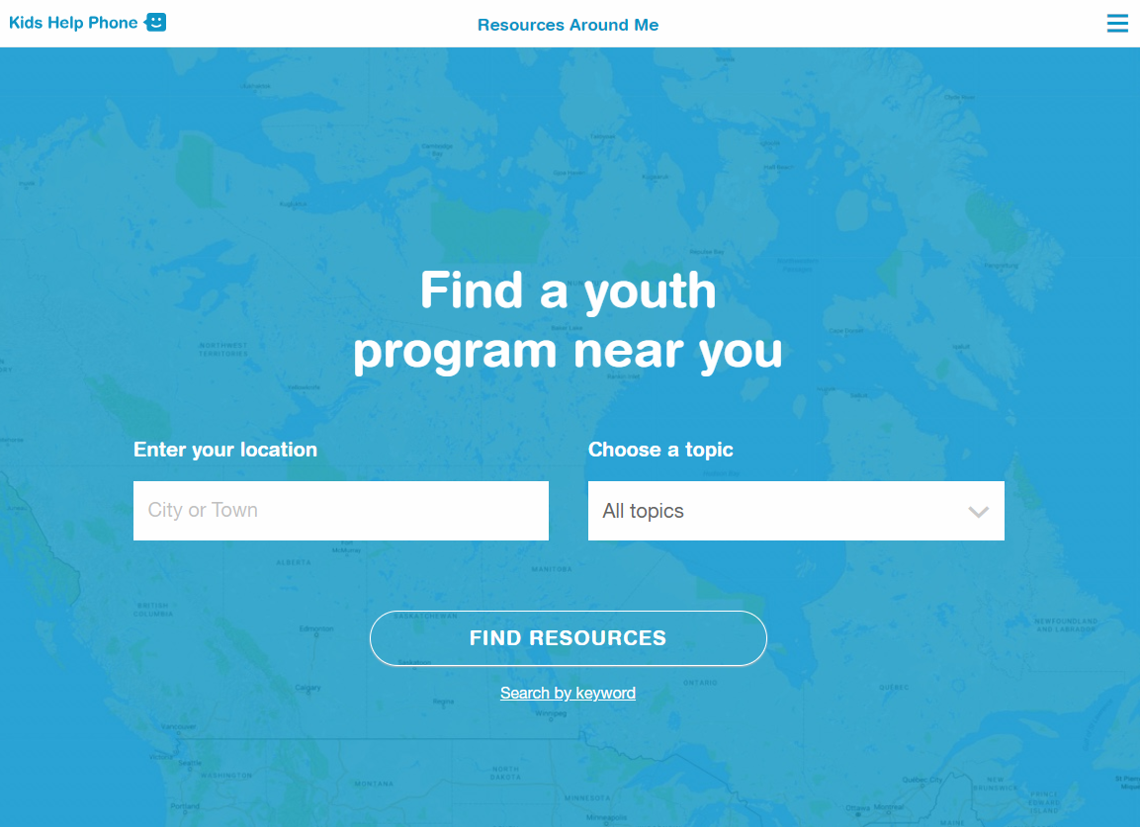
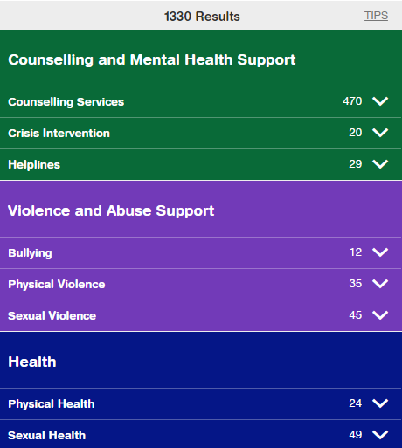
RESOURCES AROUND ME
Resources Around Me is a free, interactive tool, available in English and French, through Kids Help Phone’s website.
The tool helps young people to independently connect to local programs and services in their communities.
These services include:
Counseling and mental health
Sexual health
Housing help
Legal help
LGBTQ2S services
Youth shelters
kidshelpphone.ca/resourcesaroundme
2 / 2

Slide 15
Community Resources
Add local resources to this slide
1 / 1

