Slide 1

Lesson 5
Social media and
online sexual exploitation
Ages 15–18

Slide 2

Digital consent
“Consent” is when you agree to something. There are many different factors to consider when we talk about sexual consent.
Those factors are the same, whether we are talking about sexual consent or digital consent.
2 / 8

Slide 3
why Do youth sext?
To show trust and intimacy to their partner
To explore sexuality with their partner
To show interest in another person
To experiment before physical sexual activity
To stay connected long distance
To give in to pressure from another person
3 / 8

Slide 4
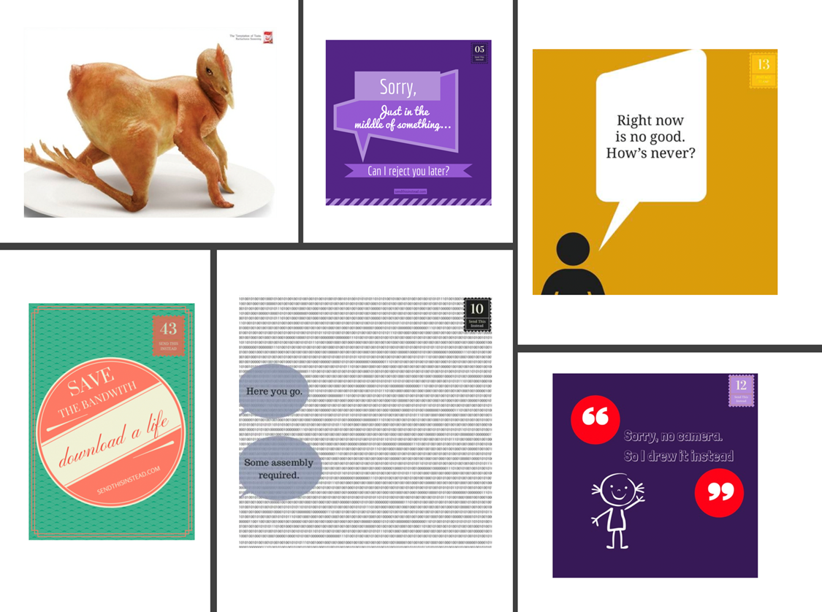
Send A MEME instead
4 / 8

Slide 5
sextortion
“Sextortion” is when someone threatens to send a sexual image or video of someone to other people if they do not meet certain demands (pay money, send more nude images, or meet them in person).
5 / 8

Slide 6
Responding to online sexual exploitation
STEP 1: STOP.
STEP 2: BLOCK.
STEP 3: DEACTIVATE.
Immediately stop all communication.
Block the exploiter from all your accounts.
Deactivate (but do not delete) all the social media accounts that you used to message with the person.
6 / 8

Slide 7
Responding to online sexual exploitation
STEP 4: talk.
Talk to a safe adult and get support.
You do not have to deal with online sexual exploitation on your own.
There are people available to help you.
7 / 8

Slide 8
Responding to online sexual exploitation
STEP 5: Report.
Contact Cybertip.ca to report the online sexual exploitation.
You can also call your local law enforcement agency and speak with an investigator.
If you have been victimized because your image is being shared without permission, NeedHelpNow.ca can help.
If you are in immediate danger, contact the police.
8 / 8

Slide 9




LINK
LOOK
LISTEN
LIVE
1 / 5
Notes:
Copyright © 2020 The Canadian Red Cross Society
LOOK: Are they acting different than before? Are they: sad, anxious, angry, and alone all the time, drinking and using drugs, taking big risks, hurting themselves or others.
We need to be looking out for each other and checking in with teammates and friends.

Slide 10
STEP 1: LOOK
Sad
Angry
Taking big risks
Hurting themselves or others
Using drugs and alcohol
Anxious
Alone
2 / 5
Notes:
Copyright © 2020 The Canadian Red Cross Society
LOOK: Are they acting different than before? Are they: sad, anxious, angry, and alone all the time, drinking and using drugs, taking big risks, hurting themselves or others.
We need to be looking out for each other and checking in with teammates and friends.

Slide 11
STEP 2: LISTEN
Are you okay?
Can I help?
Be calm
Be open
Listen without judgment
3 / 5
Notes:
Copyright © 2020 The Canadian Red Cross Society
LOOK: Are they acting different than before? Are they: sad, anxious, angry, and alone all the time, drinking and using drugs, taking big risks, hurting themselves or others.
We need to be looking out for each other and checking in with teammates and friends.

Slide 12
STEP 3: LINK
Cadet / JCR Leaders
Parents / Caregivers
Counsellors /
Teachers
Friends
Kids Help Phone
4 / 5
Notes:
Then we need to link them to people and/or resources.
LINK: Let them know there are people who can help. Encourage them to talk to a trusted adult or offer to go with them to talk to someone who can help. Let them know, “I want you to be safe; we need to get help.”
Copyright © 2020 The Canadian Red Cross Society
LOOK: Are they acting different than before? Are they: sad, anxious, angry, and alone all the time, drinking and using drugs, taking big risks, hurting themselves or others.
We need to be looking out for each other and checking in with teammates and friends.

Slide 13
STEP 4: LIVE
Journal
Sports / Exercise
Eat healthy
Music
Bead /
Sew /
Draw / Poetry
Time with animals
Hunt / Hike / Nature
Video / Movie theatre
Socialize
Talk to family and friends
5 / 5
Notes:
We want to ensure you are using healthy coping mechanism to deal with your stress.
What are some healthy ways to deal with stress? Have the players brainstorm a list then read out the ones on the PP.
Copyright © 2020 The Canadian Red Cross Society
LOOK: Are they acting different than before? Are they: sad, anxious, angry, and alone all the time, drinking and using drugs, taking big risks, hurting themselves or others.
We need to be looking out for each other and checking in with teammates and friends.

Slide 14





KIDS HELP PHONE
If you need one-on-one time with someone who gets what is going on in your life, you can connect anonymously with Kids Help Phone. Our counsellors are available 24 hours a day, seven days a week to support you with whatever you are going through.
CALL 1-800-668-6868 to talk with a counsellor
CHAT with a counsellor at KidsHelpPhone.ca or through the Always There App
TEXT 686868 to connect with a trained volunteer Crisis Responder
1 / 2

Slide 15
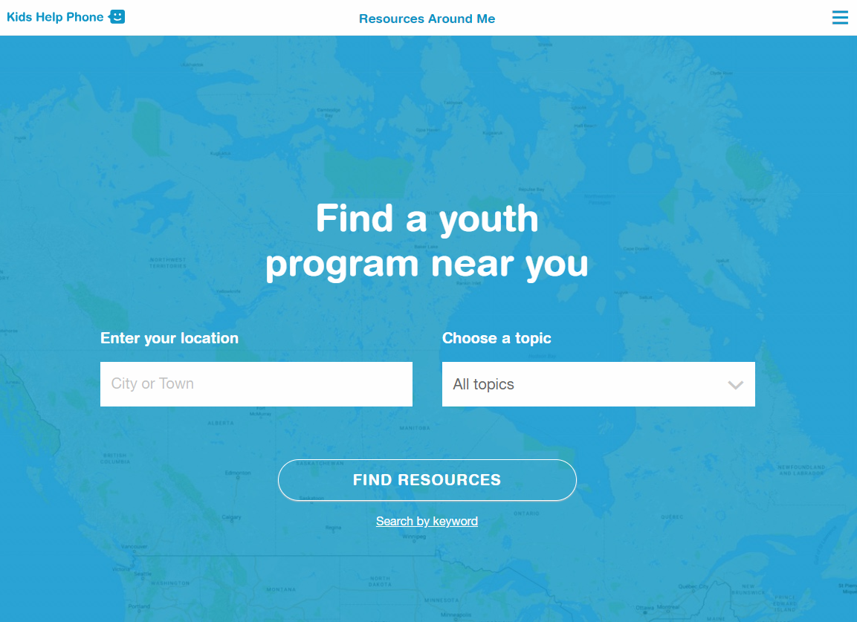
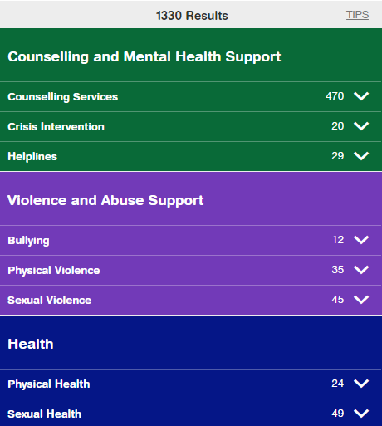
RESOURCES AROUND ME
Resources Around Me is a free, interactive tool, available in English and French, through Kids Help Phone’s website.
The tool helps young people to independently connect to local programs and services in their communities.
These services include:
  Counseling and mental health
  Sexual health
  Housing help
  Legal help
  LGBTQ2S services
  Youth shelters
kidshelpphone.ca/resourcesaroundme
2 / 2

Slide 16
Community Resources
Add local resources to this slide
1 / 1

