Slide 1
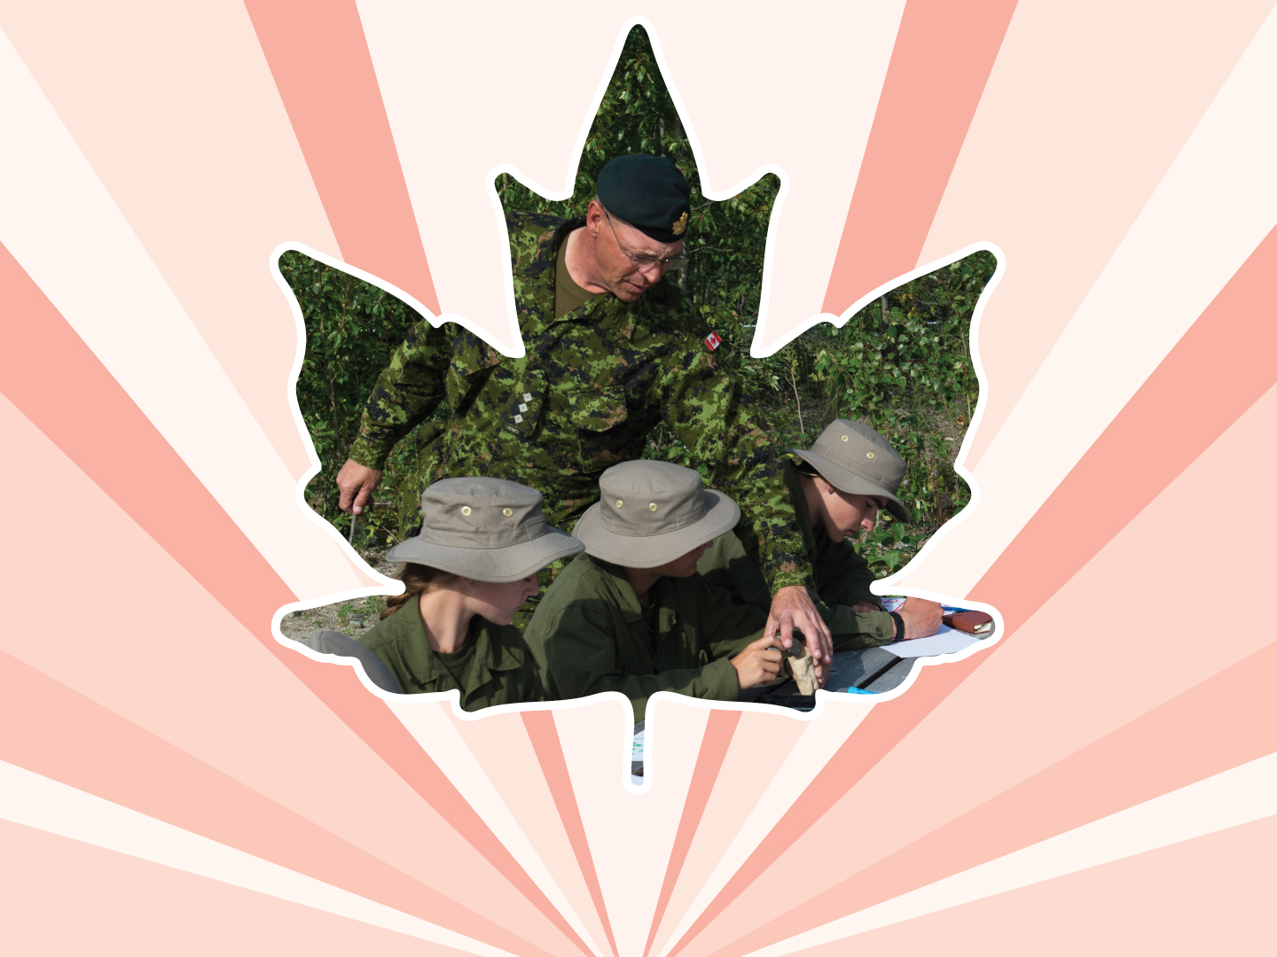
Lesson 6
Physical assault
Ages 15–18

Slide 2
Physical assault
“Physical assault” is the intentional use of force, or threats of force, on another person in an attempt to control behaviour, intimidate, or punish.
2 / 10

Slide 3
Levels of physical assault
Assault is using force or threats of force;
Assault with a weapon or causing bodily harm is:
  Use of, or threat of using, a weapon for the purpose of assault; and
  “Bodily harm” is any hurt or injury that interferes with a person’s health or comfort; and
Aggravated Assault is an assault that wounds, disfigures, or endangers the life of another person.
3 / 10

Slide 4
ROUGHHOUSE PLAY VERSUS physical assault
ROUGHHOUSE PLAY / PLAY FIGHTING | PHYSICAL FIGHTING
Happens between friends | Usually happens between people who are not friends
May happen between two people, but often can include more | Usually happens between two people
Equal balance of power | One person has more power than the other
People are smiling and laughing | People are serious and tense
Intent is friendly and positive | Intent is negative and aggressive; there is a desire to inflict injury and hurt the other person
4 / 10

Slide 5

Anger mountain
Explosion / Crisis
Anger
Triggers
Recovery
Decision-making Valley
5 / 10
Notes:
Talk about anger and how it can impact our lives. Go through anger mountain. Show Just breathe video for calming down. Anger is a core normal emotion. Uncontrolled angers follows a predictable pattern, and because it follows a pattern it is possible to use strategies to manage it.
Arrow represents the a state of balance and calm. People move above and below the line throughout the day, depending on how they feel and what is happening in their lives.
We all have triggers. Those things that cause us stress and make us angry.
Physical and emotional responses – How do you feel when you are getting angry?
Explosion/Crisis: When people let their anger get out of control, the line slopes upwards in a predictable mountain – like pattern.
How does it feel at this point/ What can happen at this point?
Recovery: Point of the ascending slope that follows the peak. What are you feeling at this stage?
When our anger climbs up the mountain\, our decision making abilities form a deep valley. As we become angry, our ability to think clearly, reason logically, and make smart decisions decreases. At the top of anger mountain, we demonstrate the lowest level of rational thinking. We find it hard to think about our actions and consequences. When we come down anger mountain, our ability to reason increases.
When we understand what triggers us to get angry and how our body changes, then we can recognize those changes and take steps to calm down before we reach the point of exploding.

Slide 6

TRIGGERS
1. Triggers
Parents don’t
listen to you
Siblings take your things without asking
6 / 10
Notes:
Source: Pepler, D., & Craig, W. (2000). Making a difference in bullying. (No. 60). Toronto, ON: LaMarsh Centre for Research on Violence and Conflict Resolution and Queen’s University.

Slide 7
physical and emotional responses
2. Physical & emotional responses
Sweaty hands
Chest tight
Fast heart rate
Breathing faster
1. Triggers
Parents don’t
listen to you
Siblings take your things without asking
7 / 10
Notes:
Source: Pepler, D., & Craig, W. (2000). Making a difference in bullying. (No. 60). Toronto, ON: LaMarsh Centre for Research on Violence and Conflict Resolution and Queen’s University.

Slide 8
Explosion
2. Physical & emotional responses
3. Explosion / crisis
Sweaty hands
Chest tight
Fast heart rate
Breathing faster
Yelling
Hitting
Kicking
1. Triggers
Parents don’t
listen to you
Siblings take your things without asking
8 / 10
Notes:
Source: Pepler, D., & Craig, W. (2000). Making a difference in bullying. (No. 60). Toronto, ON: LaMarsh Centre for Research on Violence and Conflict Resolution and Queen’s University.

Slide 9
Recovery
2. Physical & emotional responses
3. Explosion / crisis
Sweaty hands
Chest tight
Fast heart rate
Breathing faster
Yelling
Hitting
Kicking
4. recovery
Guilt
Remorse
Shame
Sadness
1. Triggers
Parents don’t
listen to you
Siblings take your things without asking
9 / 10
Notes:
Source: Pepler, D., & Craig, W. (2000). Making a difference in bullying. (No. 60). Toronto, ON: LaMarsh Centre for Research on Violence and Conflict Resolution and Queen’s University.

Slide 10
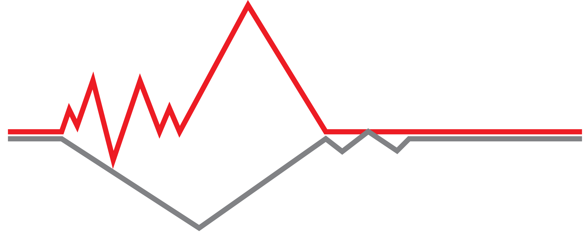
Logical thinking
10 / 10
Notes:
Source: Pepler, D., & Craig, W. (2000). Making a difference in bullying. (No. 60). Toronto, ON: LaMarsh Centre for Research on Violence and Conflict Resolution and Queen’s University.

Slide 11




LINK
LOOK
LISTEN
LIVE
1 / 5
Notes:
Copyright © 2020 The Canadian Red Cross Society
LOOK: Are they acting different than before? Are they: sad, anxious, angry, and alone all the time, drinking and using drugs, taking big risks, hurting themselves or others.
We need to be looking out for each other and checking in with teammates and friends.

Slide 12
STEP 1: LOOK
Sad
Angry
Taking big risks
Hurting themselves or others
Using drugs and alcohol
Anxious
Alone
2 / 5
Notes:
Copyright © 2020 The Canadian Red Cross Society
LOOK: Are they acting different than before? Are they: sad, anxious, angry, and alone all the time, drinking and using drugs, taking big risks, hurting themselves or others.
We need to be looking out for each other and checking in with teammates and friends.

Slide 13
STEP 2: LISTEN
Are you okay?
Can I help?
Be calm
Be open
Listen without judgment
3 / 5
Notes:
Copyright © 2020 The Canadian Red Cross Society
LOOK: Are they acting different than before? Are they: sad, anxious, angry, and alone all the time, drinking and using drugs, taking big risks, hurting themselves or others.
We need to be looking out for each other and checking in with teammates and friends.

Slide 14
STEP 3: LINK
Cadet / JCR Leaders
Parents / Caregivers
Counsellors /
Teachers
Friends
Kids Help Phone
4 / 5
Notes:
Then we need to link them to people and/or resources.
LINK: Let them know there are people who can help. Encourage them to talk to a trusted adult or offer to go with them to talk to someone who can help. Let them know, “I want you to be safe; we need to get help.”
Copyright © 2020 The Canadian Red Cross Society
LOOK: Are they acting different than before? Are they: sad, anxious, angry, and alone all the time, drinking and using drugs, taking big risks, hurting themselves or others.
We need to be looking out for each other and checking in with teammates and friends.

Slide 15
STEP 4: LIVE
Journal
Sports / Exercise
Eat healthy
Music
Bead /
Sew /
Draw / Poetry
Time with animals
Hunt / Hike / Nature
Video / Movie theatre
Socialize
Talk to family and friends
5 / 5
Notes:
We want to ensure you are using healthy coping mechanism to deal with your stress.
What are some healthy ways to deal with stress? Have the players brainstorm a list then read out the ones on the PP.
Copyright © 2020 The Canadian Red Cross Society
LOOK: Are they acting different than before? Are they: sad, anxious, angry, and alone all the time, drinking and using drugs, taking big risks, hurting themselves or others.
We need to be looking out for each other and checking in with teammates and friends.

Slide 16


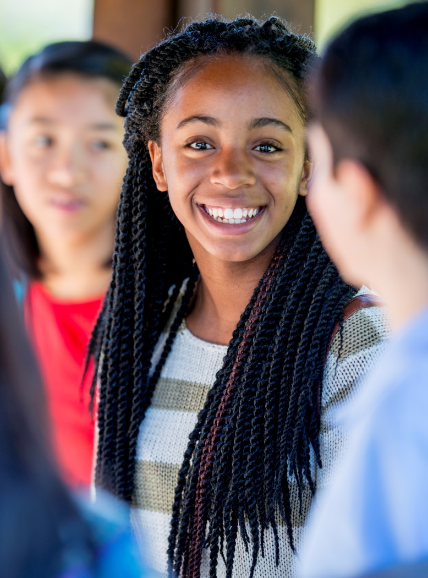


KIDS HELP PHONE
If you need one-on-one time with someone who gets what is going on in your life, you can connect anonymously with Kids Help Phone. Our counsellors are available 24 hours a day, seven days a week to support you with whatever you are going through.
CALL 1-800-668-6868 to talk with a counsellor
CHAT with a counsellor at KidsHelpPhone.ca or through the Always There App
TEXT 686868 to connect with a trained volunteer Crisis Responder
1 / 2

Slide 17
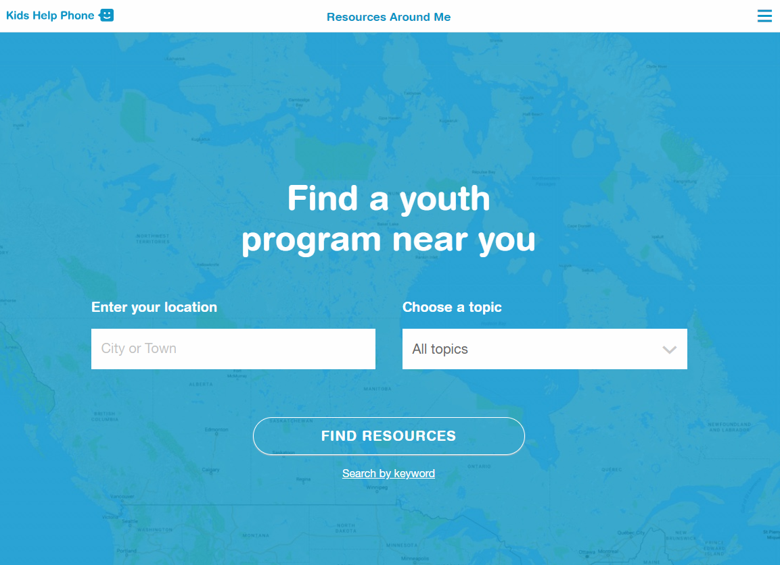
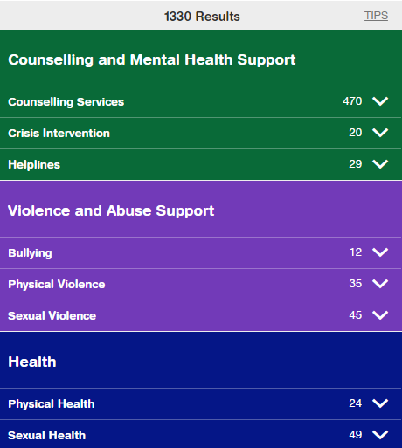
RESOURCES AROUND ME
Resources Around Me is a free, interactive tool, available in English and French, through Kids Help Phone’s website.
The tool helps young people to independently connect to local programs and services in their communities.
These services include:
  Counseling and mental health
  Sexual health
  Housing help
  Legal help
  LGBTQ2S services
  Youth shelters
kidshelpphone.ca/resourcesaroundme
2 / 2

Slide 18
Community Resources
Add local resources to this slide
1 / 1

